Slide 1
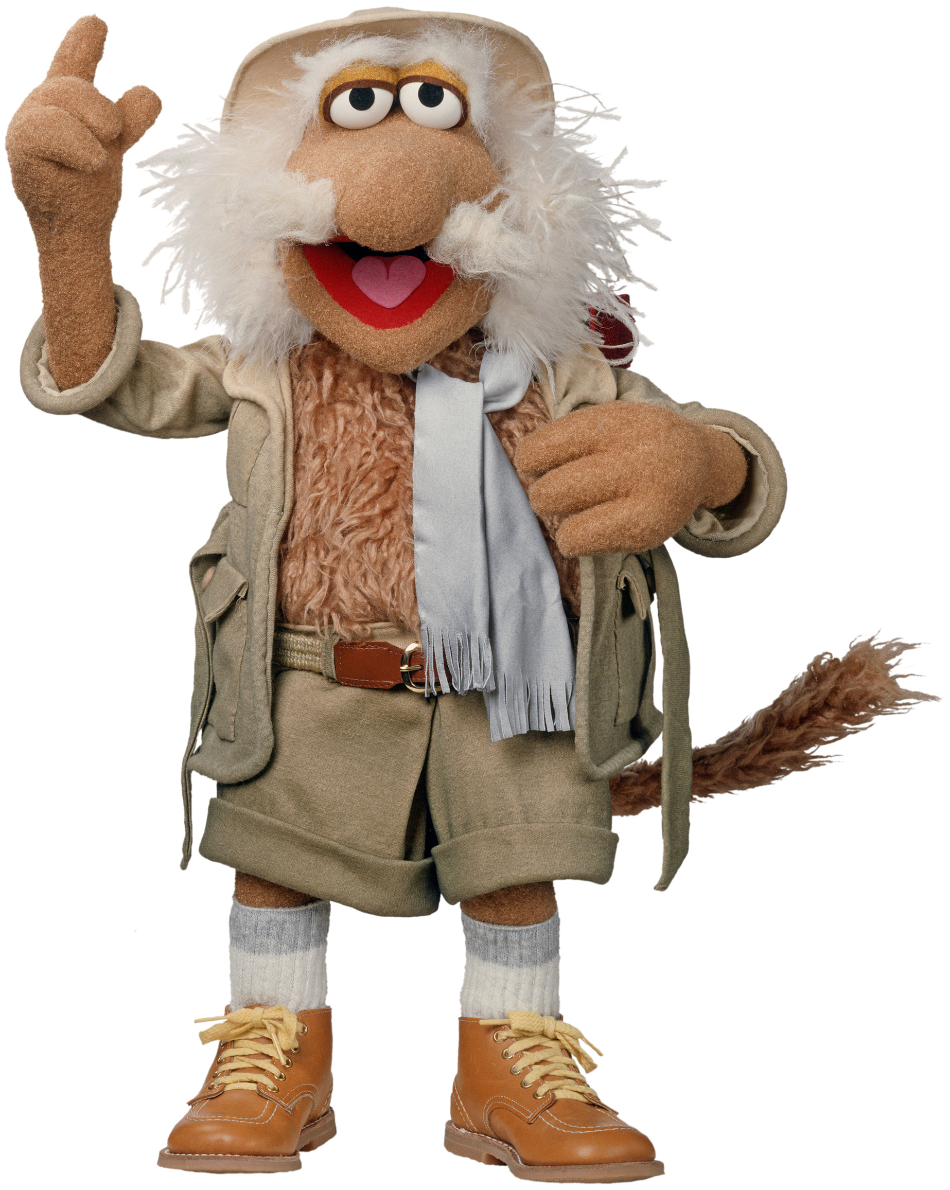
Inntrykk fra vårens programmeringskonferanser
Einar W. Høst

Slide 2

Notes:
Hva er DDD Europe?

Slide 3
Hva er DDD Europe?

Slide 4
Hvorfor DDD Europe?

Slide 5
Mitt foredrag

Slide 6
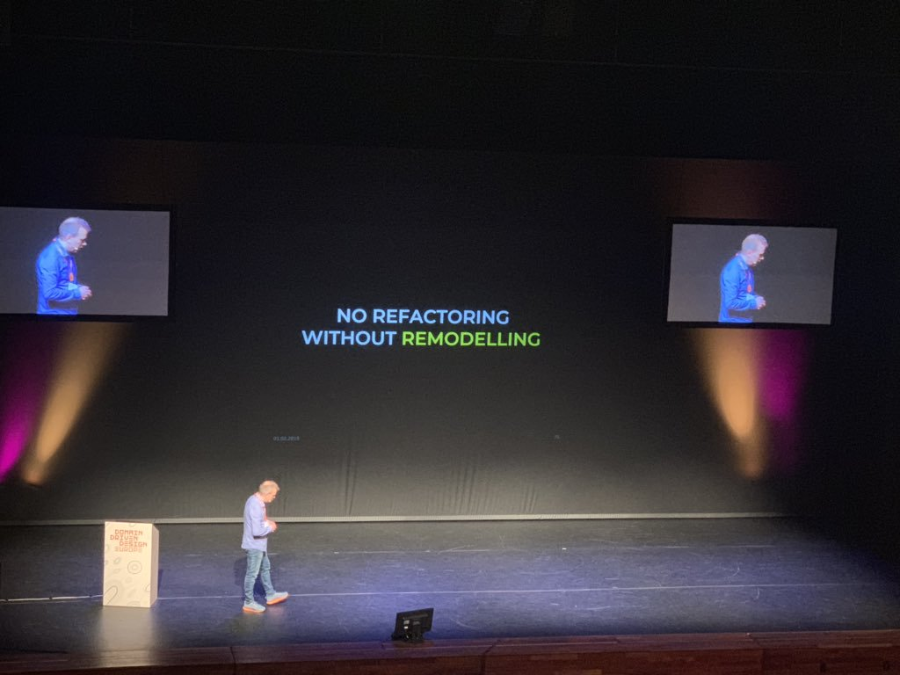
Technical debt isn’t technical

Slide 7
Sjekk ut

Slide 8
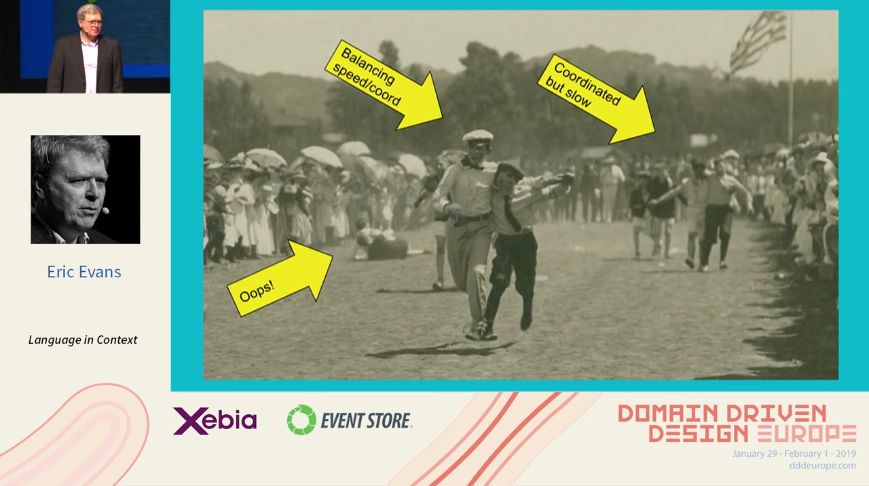
Language in Context Eric Evans
https://www.youtube.com/watch?v=jOu2hISeO5M

Slide 9
Etterhvert

Slide 10
Technology Strategy: What is it and why do we need it? Nick Tune & Scott Millett

Slide 11
Socio-technical DDD - Essential social heuristics Evelyn Van Kelle

Slide 12


Slide 13
Hva er Oslo Elm Day?

Slide 14
Hvorfor Oslo Elm Day?

Slide 15
Mitt foredrag

Slide 16
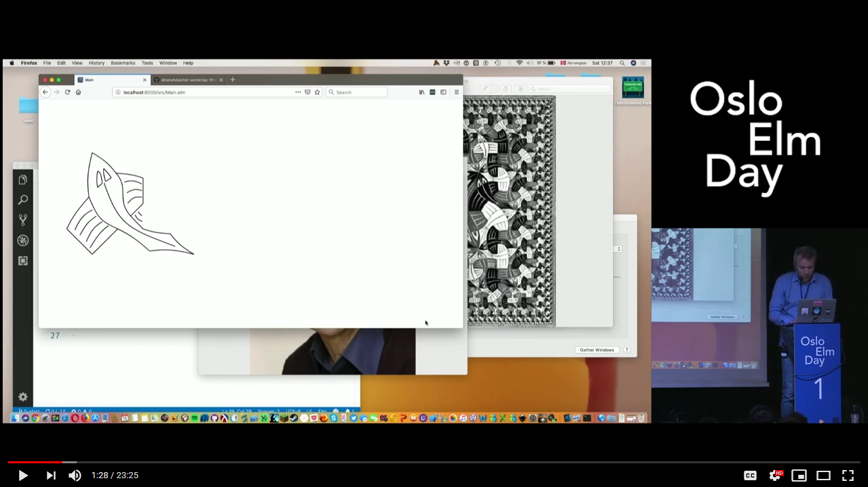
Picture Combinators and Recursive Fish
https://www.youtube.com/watch?v=jOu2hISeO5M

Slide 17
Anbefalte foredrag

Slide 18
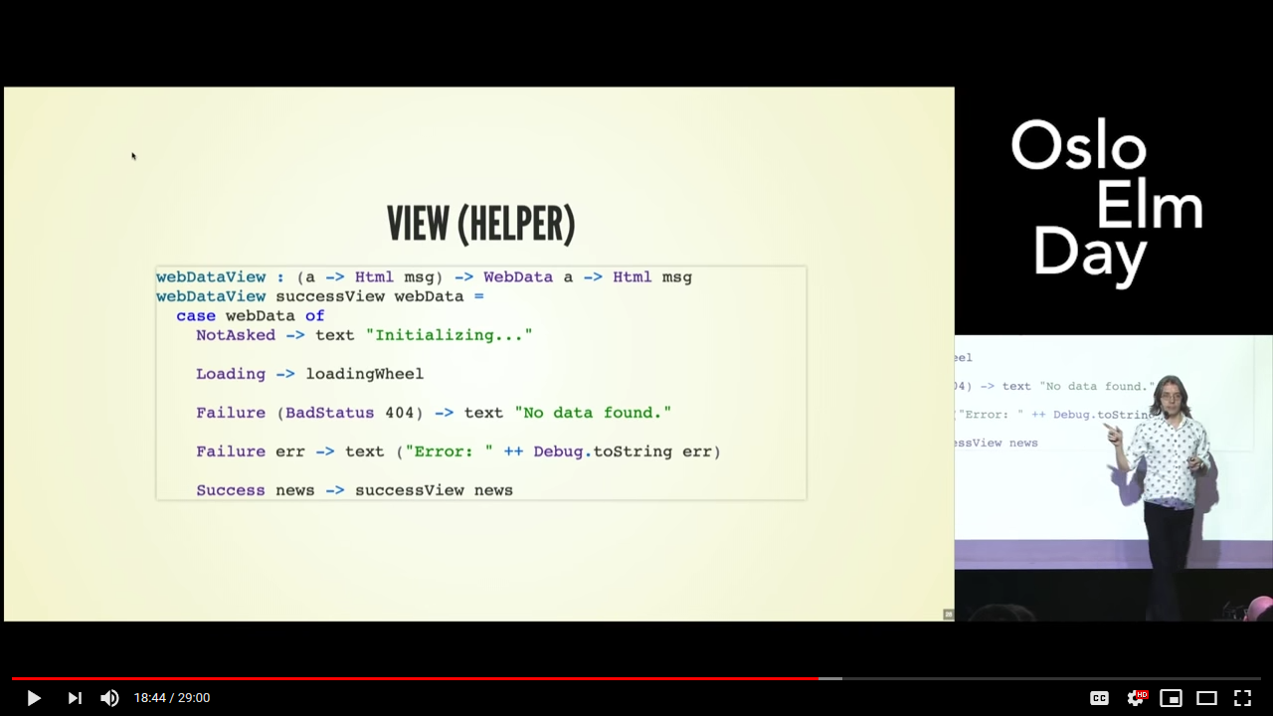
Slaying a UI Antipattern Kris Jenkins
https://www.youtube.com/watch?v=NLcRzOyrH08

Slide 19
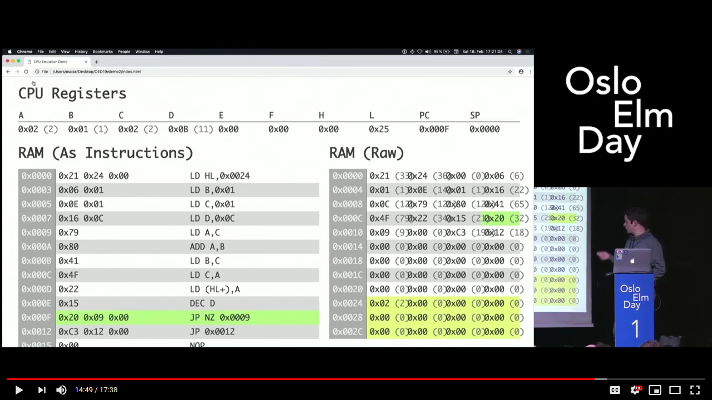
Emulating the Nintendo Game Boy CPU with Elm Manuel Fuchs
https://www.youtube.com/watch?v=vI30OvU3QW0

Slide 20
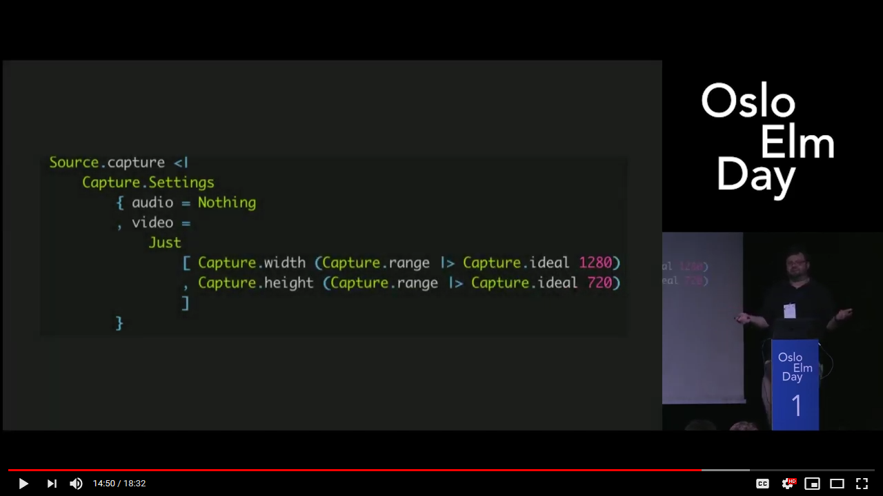
Audio, Video, and Elm - Best Practices for Multimedia Dan Abrams
https://www.youtube.com/watch?v=8jW58fXuuOk

Slide 21


Slide 22
Hva er Lambda Days?

Slide 23
Hvorfor Lambda Days?

Slide 24
Mine bidrag

Slide 25
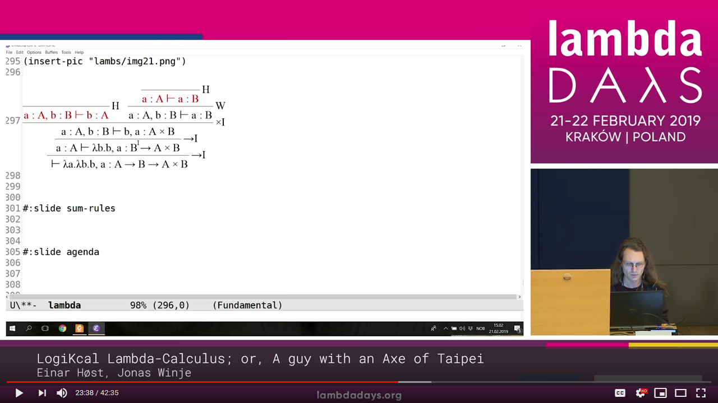
LogiKcal Lambda-Calculus; or, A guy with an Axe of Taipei (med Jonas Winje)
https://www.youtube.com/watch?v=yfkcBjQCA4k

Slide 26
Escher in Elm Workshop

Slide 27
Anbefalte foredrag

Slide 28
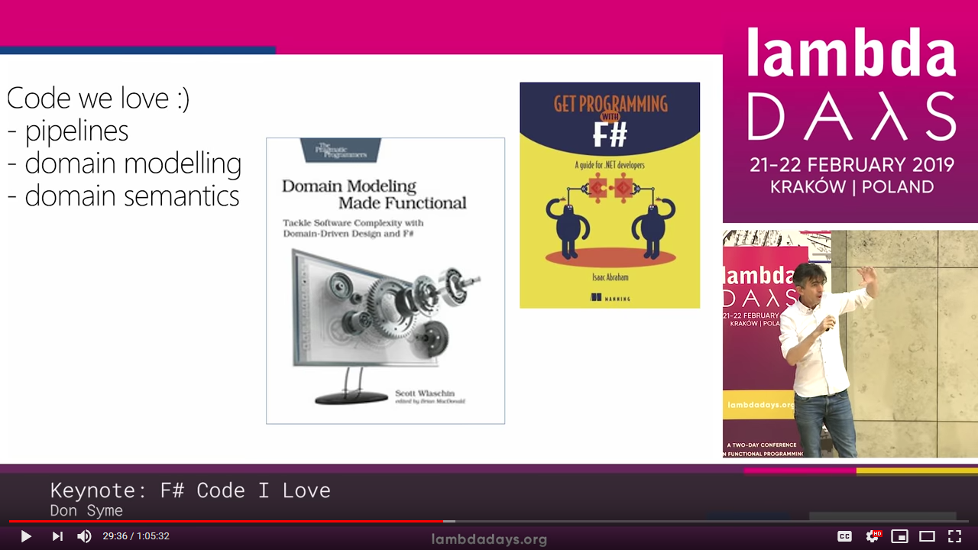
F# Code I Love Don Syme
https://www.youtube.com/watch?v=MGLxyyTF3OM

Slide 29
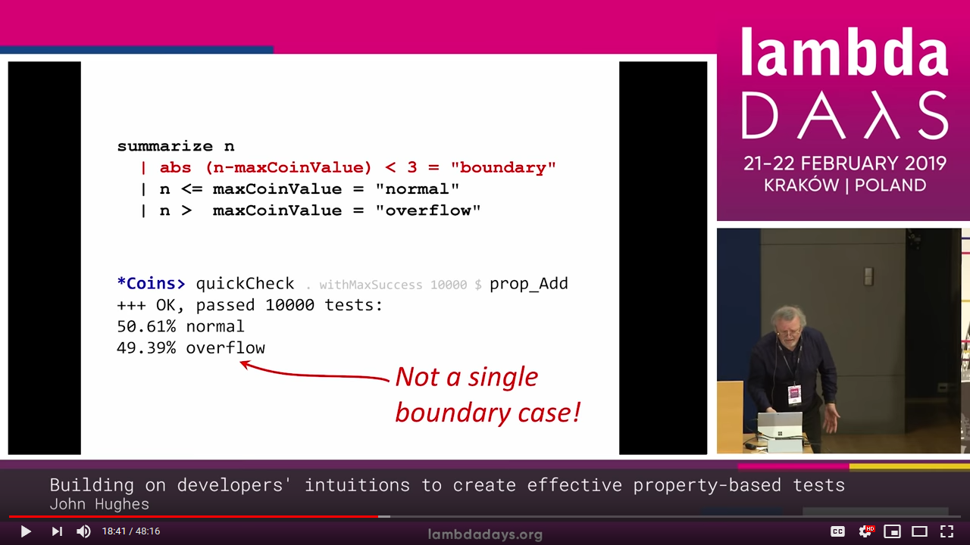
Building on developers' intuitions to create effective property-based tests John Hughes
https://www.youtube.com/watch?v=NcJOiQlzlXQ

Slide 30
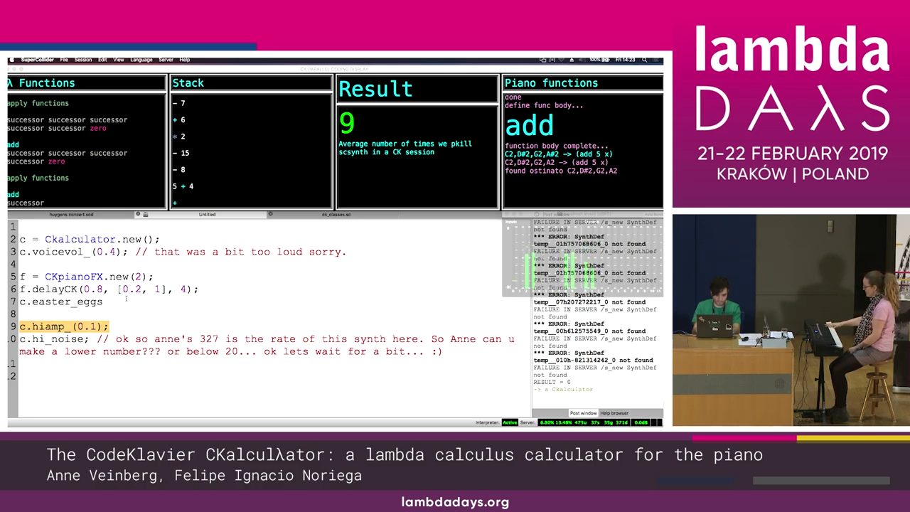
The CodeKlavier CKalcuλator Anne Veinberg & Felipe Ignacio Noriega
https://www.youtube.com/watch?v=0fL40oLU8C4

Slide 31
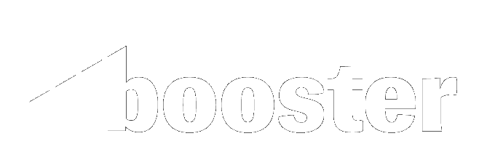

Slide 32
Hva er Booster?

Slide 33
Hvorfor Booster?

Slide 34
Mitt bidrag

Slide 35
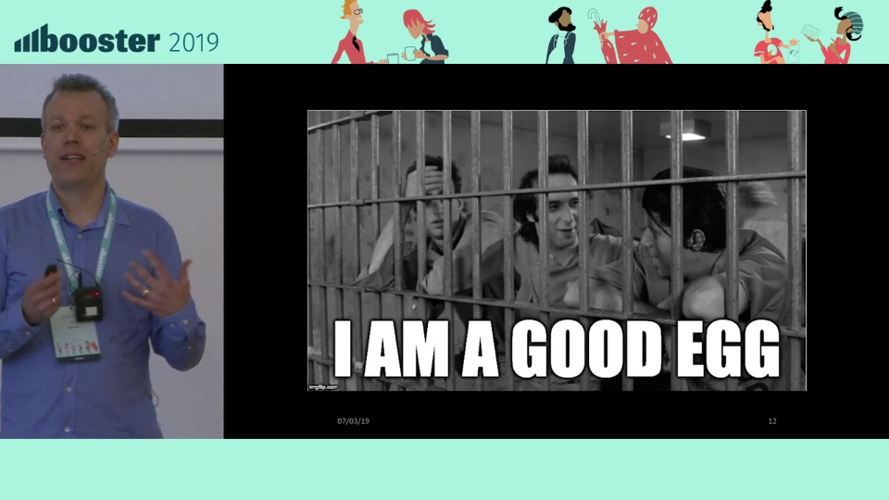
Death of a Craftsman
https://vimeo.com/323916035

Slide 36
Anbefalte foredrag

Slide 37
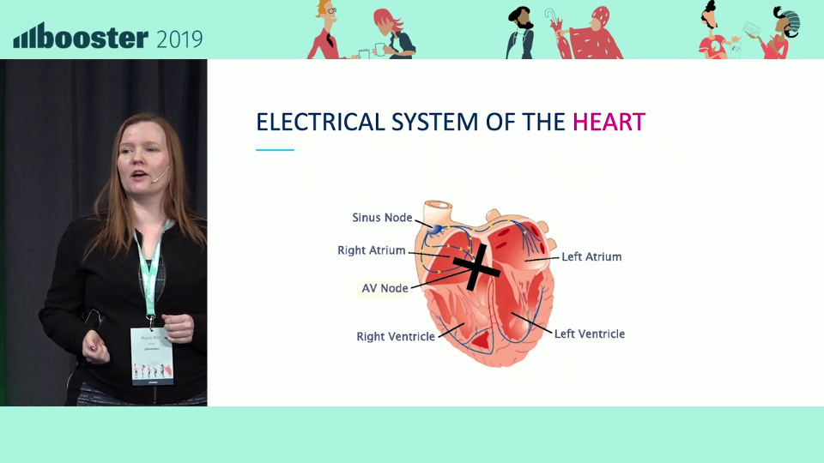
Embodied vulnerabilities – Why I am hacking my own heart Marie Moe
https://vimeo.com/324164321

Slide 38
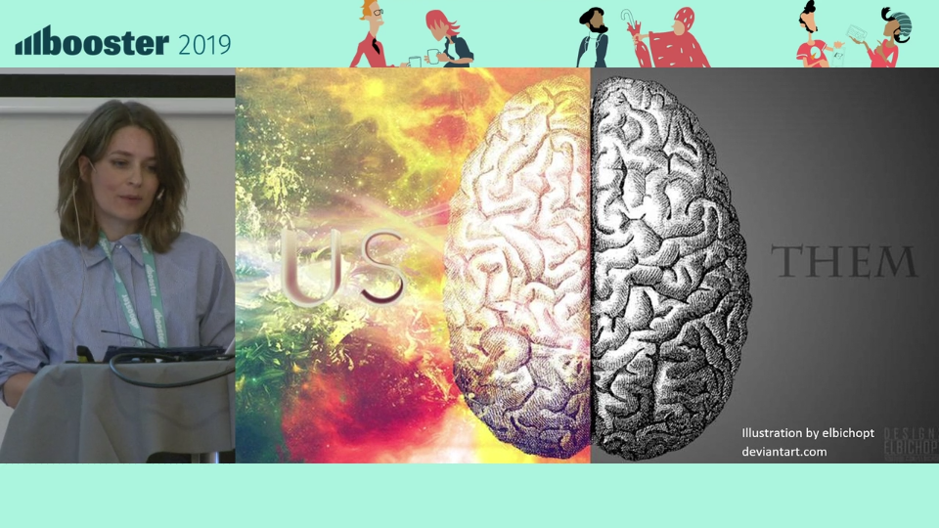
Collaboration across organizational silos Hilde Bakkeli
https://vimeo.com/325297046

Slide 39
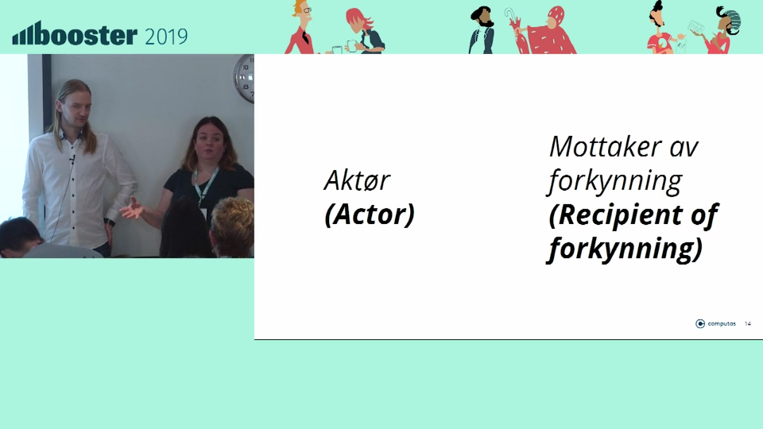
Domain driven design in the real world Mads Opheim & Anne Landro
https://vimeo.com/324159725

Slide 40
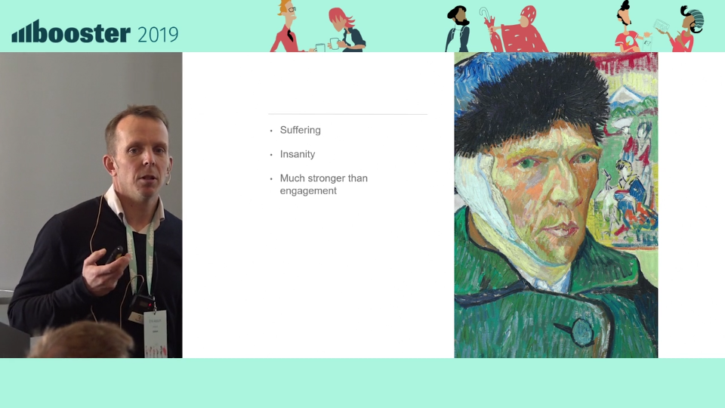
Do we have to be passionate at work? Erik Assum
https://vimeo.com/324208305

Slide 41
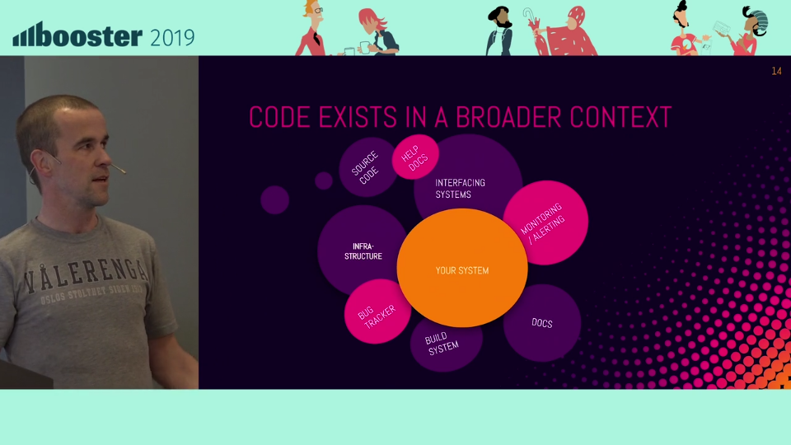
Understanding other people’s systems Espen Dalløkken
https://vimeo.com/325144791

Slide 42
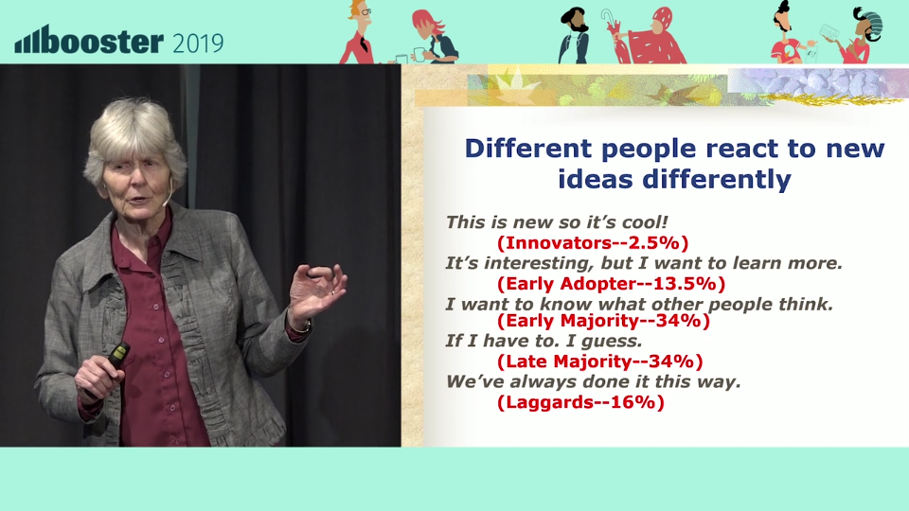
Meeting resistance and moving forward Linda Rising
https://vimeo.com/325143661

Slide 43
Mer NRK!

Slide 44
The Actor Factor Heidi Mork

Slide 45
Intro to 3D visualization and three.js Stian Veum Møllersen

Slide 46
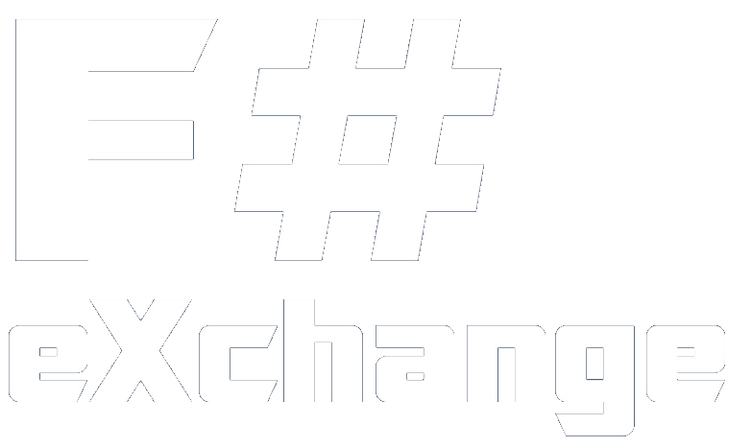

Slide 47
Hva er F# Exchange?

Slide 48
Hvorfor F# Exchange?

Slide 49
Mitt foredrag

Slide 50
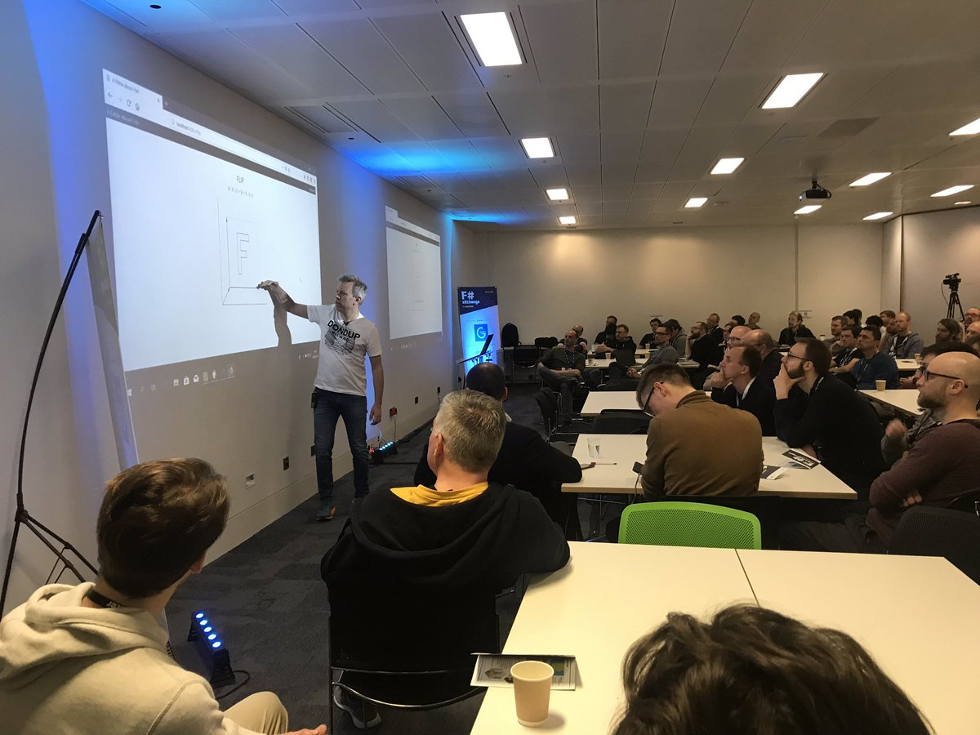
A Fable about Fish

Slide 51
Anbefalte foredrag

Slide 52
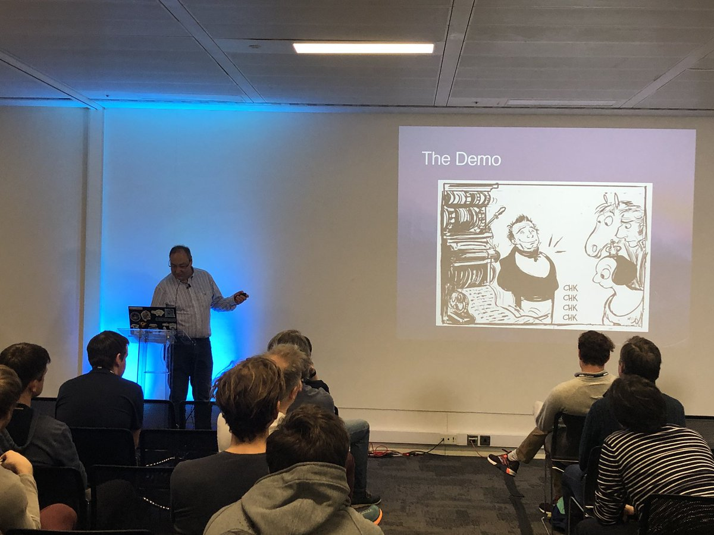
Simulating Charles Babbage's Analytical Engine in F# John Stovin

Slide 53
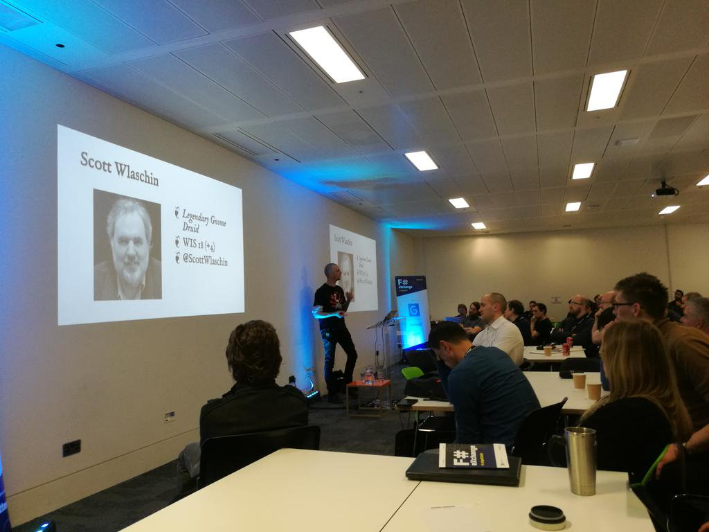
Dungeons, Dragons and Functions Mathias Brandewinder

Slide 54
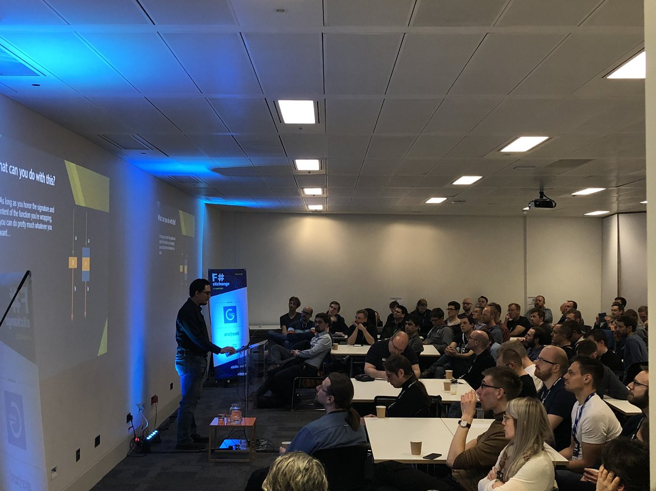
Functions as Interfaces: Extend Everything! Erik Novales

Slide 55


Slide 56
Hva er flatMap(Oslo)?

Slide 57
Hvorfor flatMap(Oslo)?

Slide 58
Mitt foredrag

Slide 59
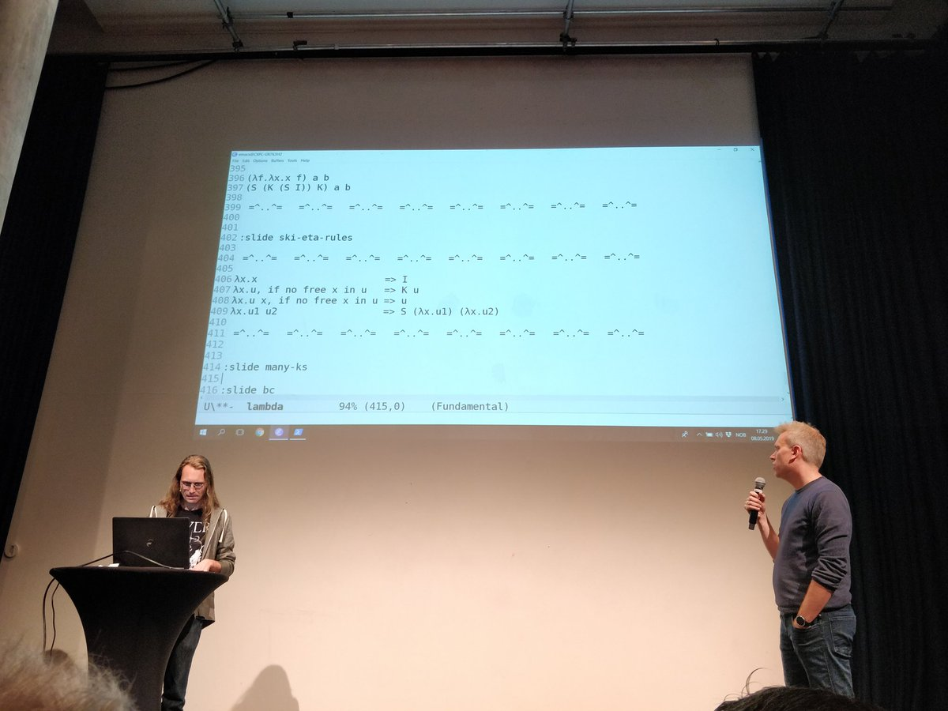
Impractical Lambda Calculus (med Jonas Winje)
https://www.youtube.com/watch?v=GElLnRy6Xoc

Slide 60
Anbefalte foredrag

Slide 61
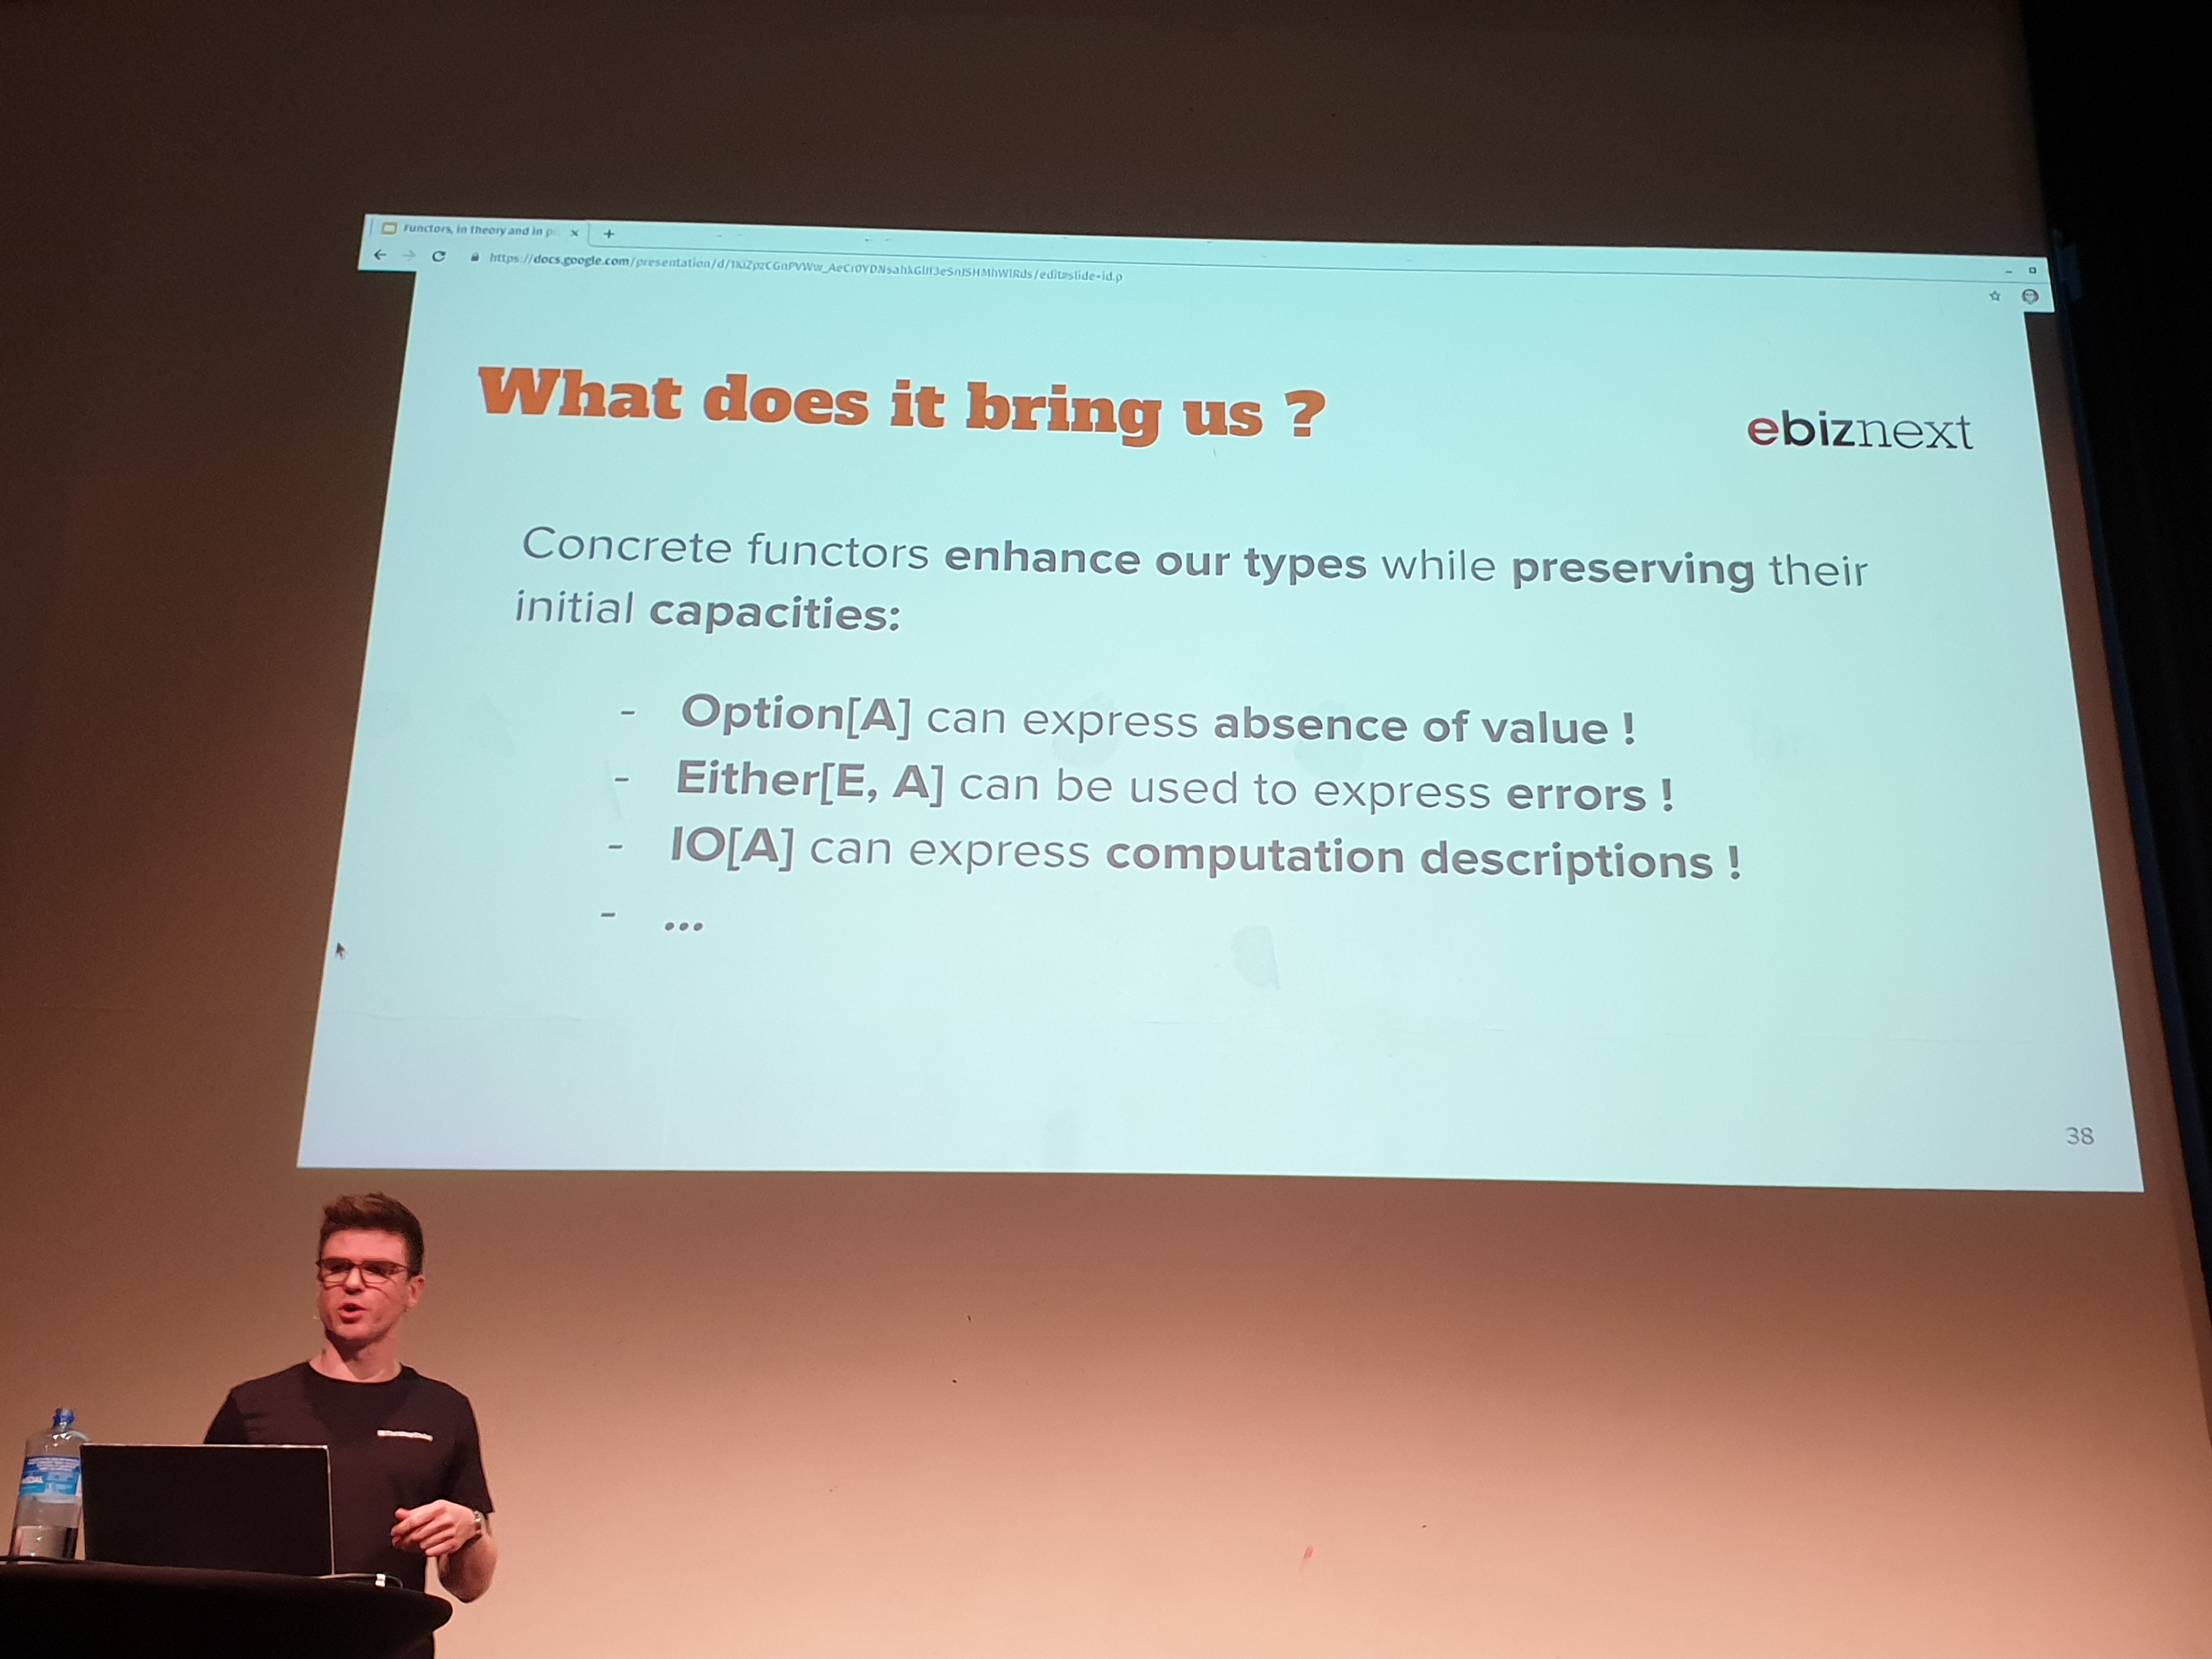
Functors, in theory and practice! Martin Menestret
https://www.youtube.com/watch?v=_zRBKHN8exA

Slide 62
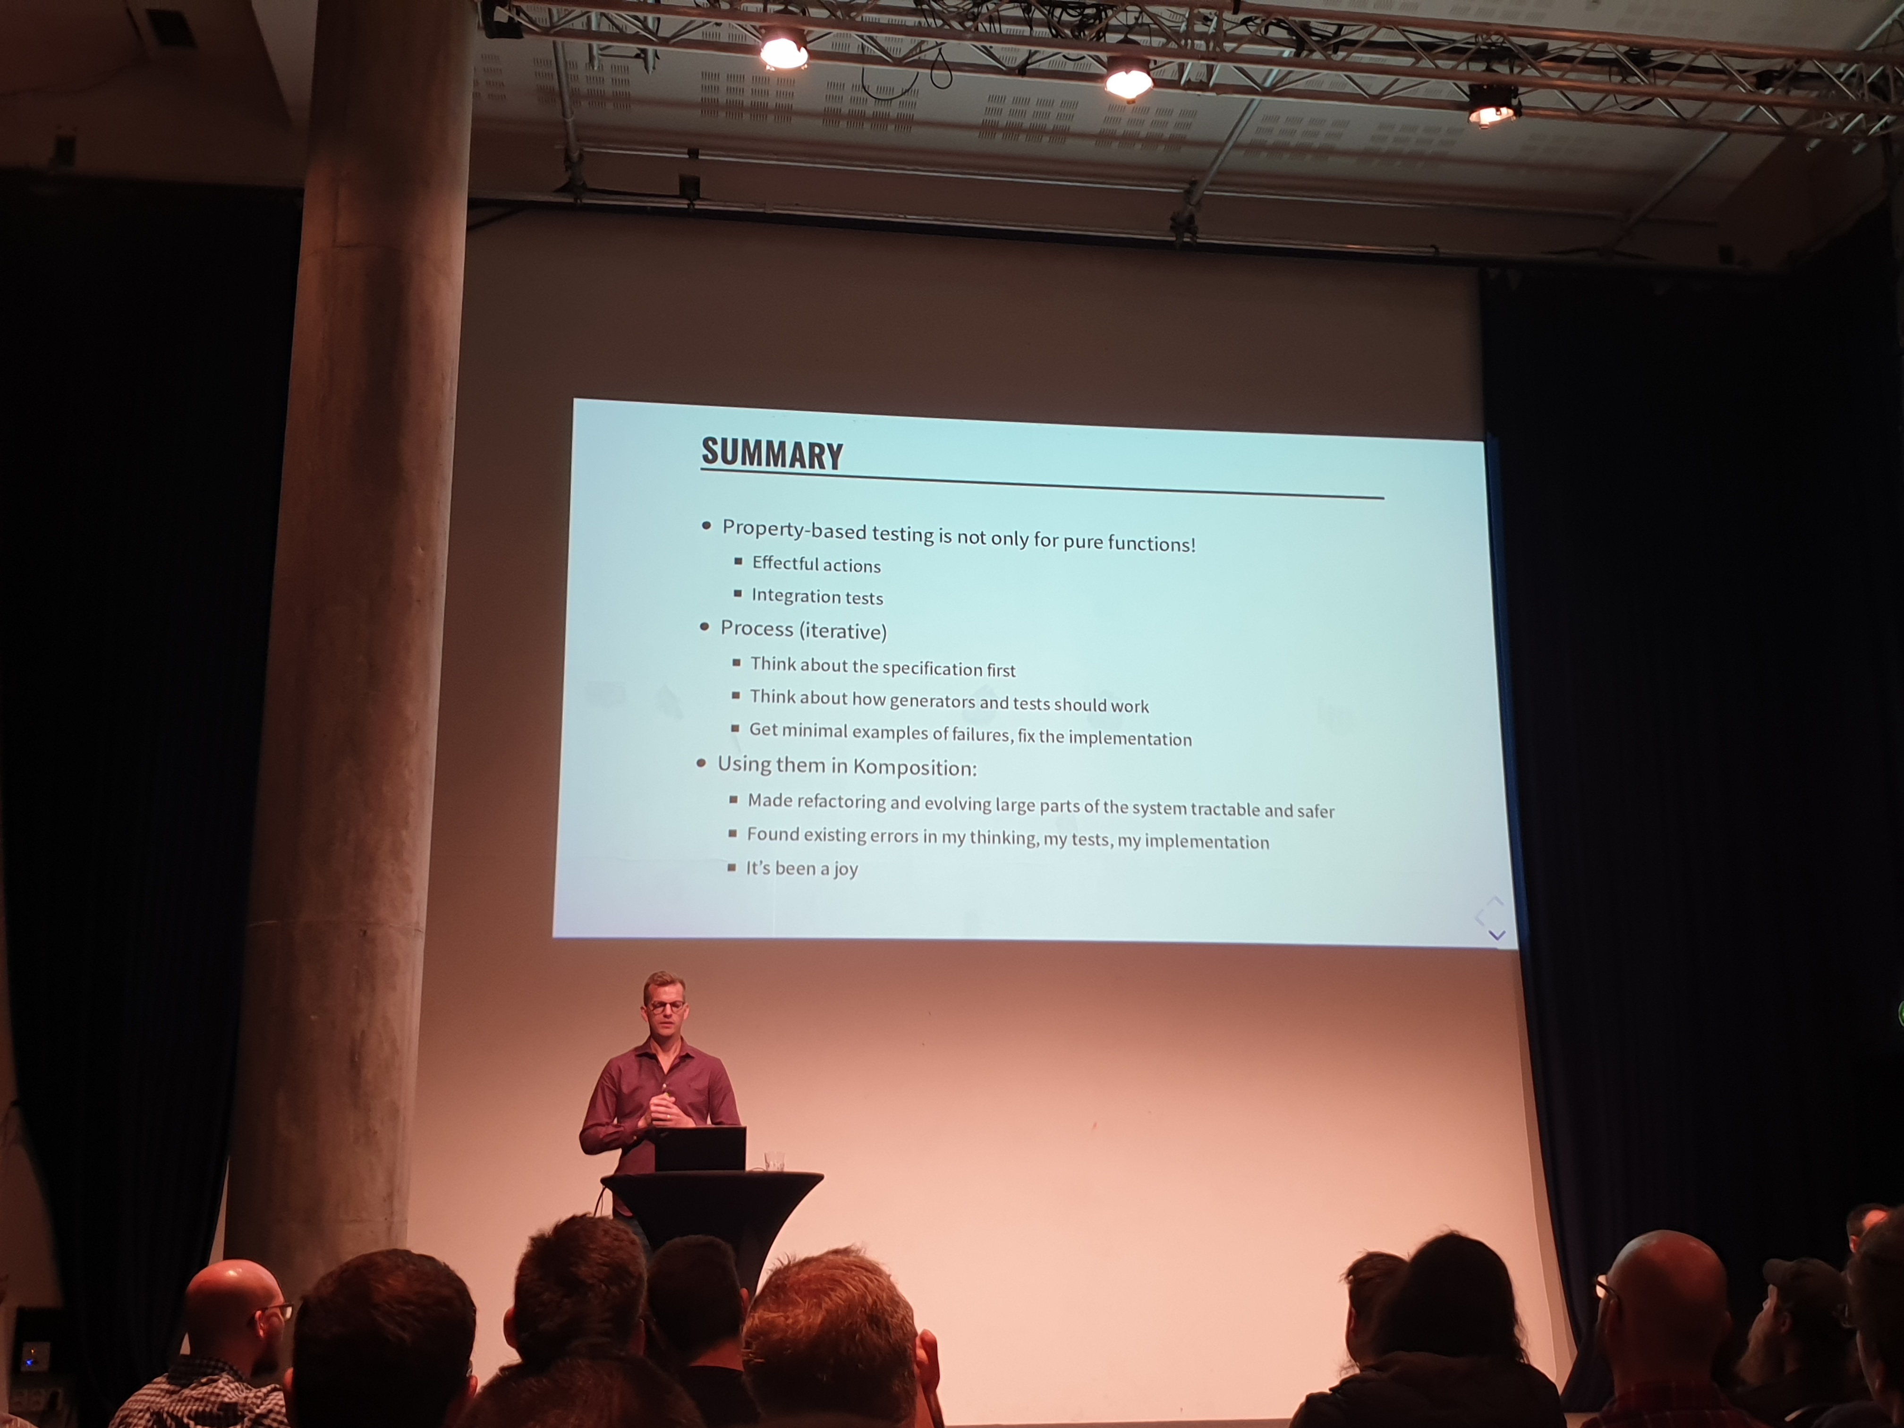
Property-Based Testing The Ugly Parts: Case Studies from Komposition Oskar Wickström
https://www.youtube.com/watch?v=z2ete8VZnZY

Slide 63
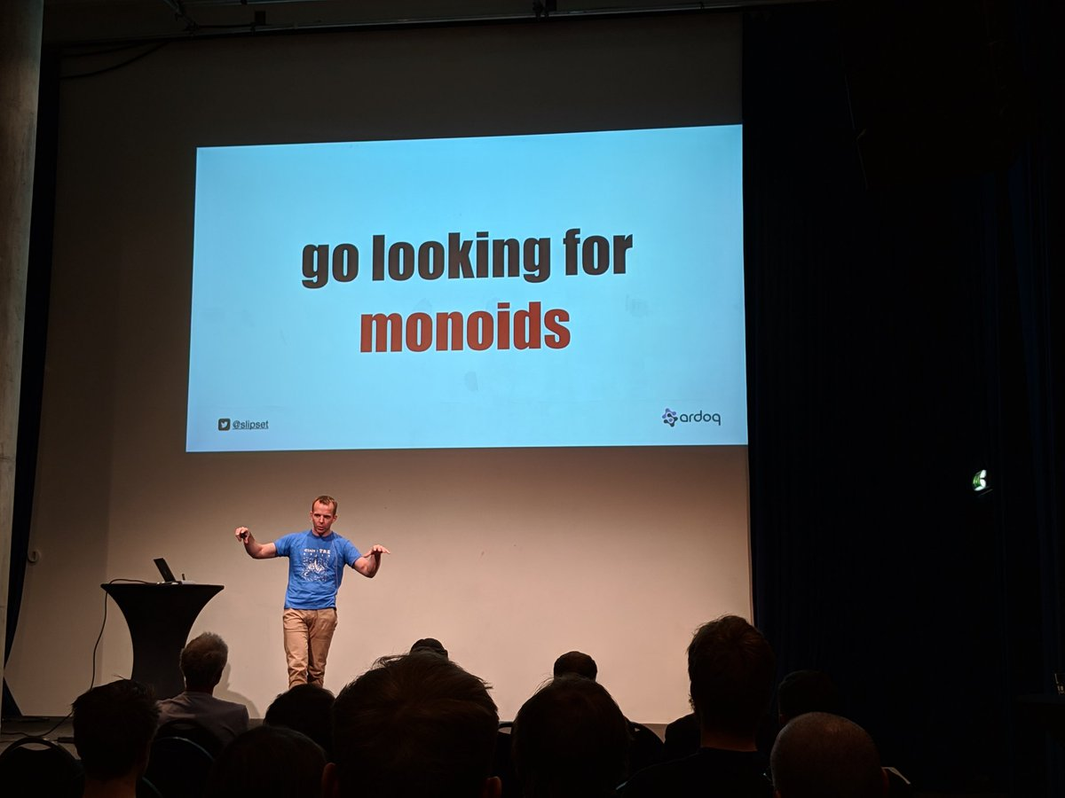
Transducers – composable algorithmic transformations Erik Assum
https://www.youtube.com/watch?v=_4sgTq4_OjM

Slide 64
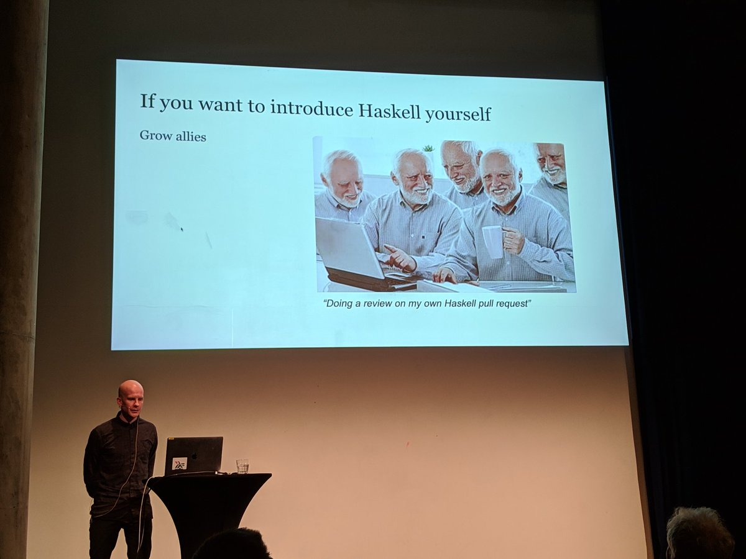
Using Haskell at FINN.no Sjur Millidahl
https://www.youtube.com/watch?v=hxXe7aWmCxc

Slide 65
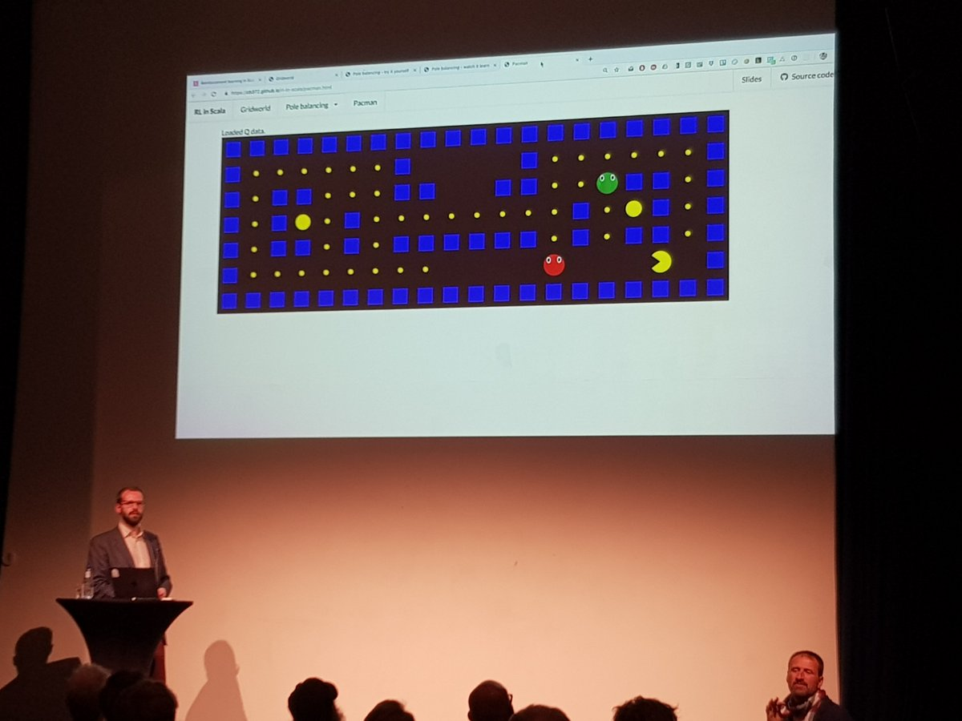
Reinforcement Learning in Scala Chris Birchall
https://www.youtube.com/watch?v=sdUpjVjPEI0

Slide 66


Slide 67
Hva er NewCrafts?

Slide 68
Hvorfor NewCrafts?

Slide 69
Mitt foredrag

Slide 70
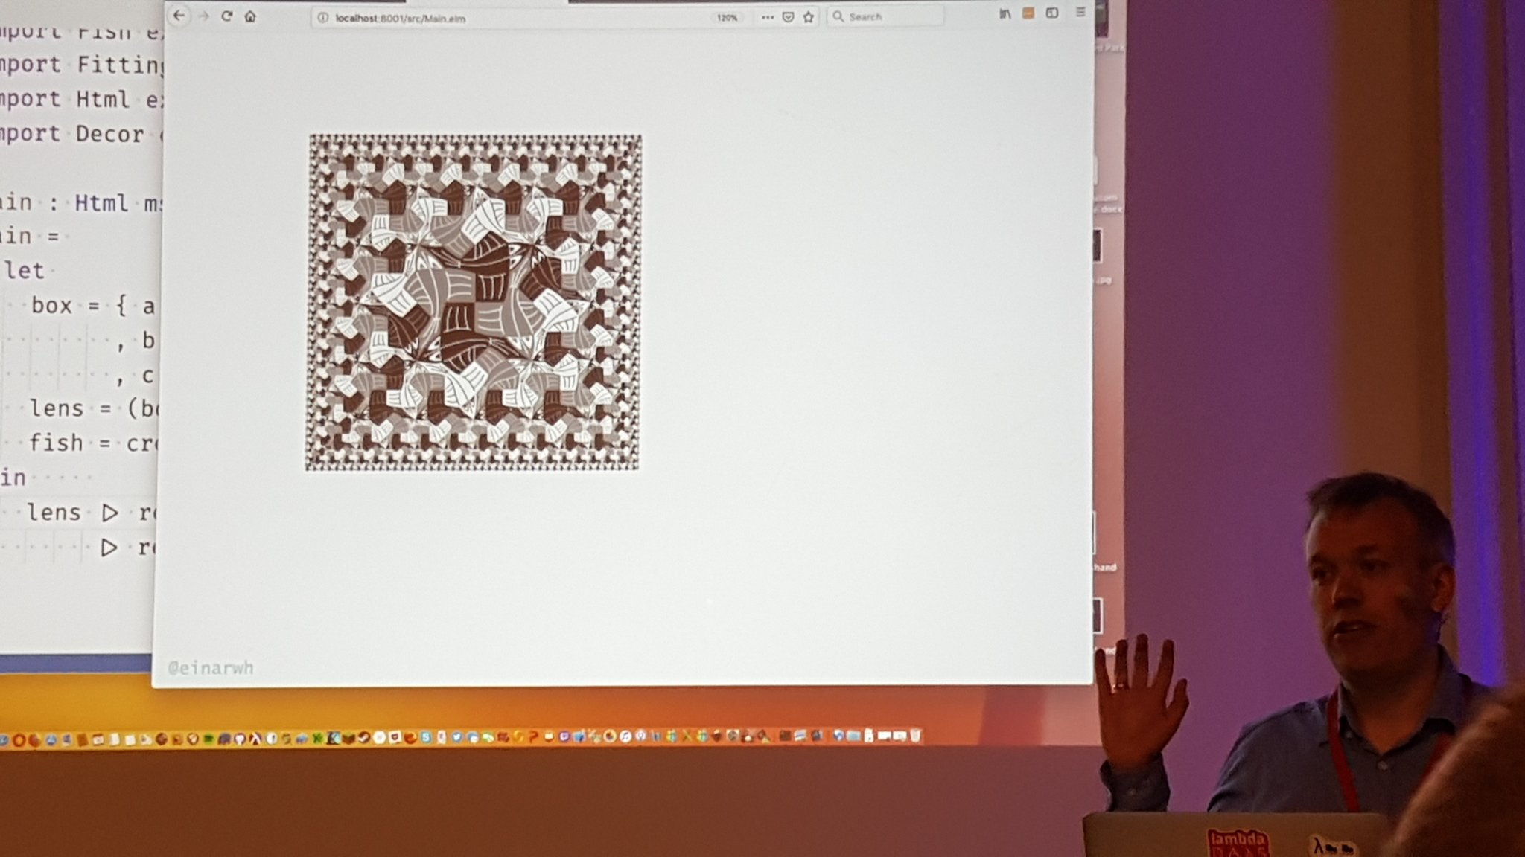
Escher in Elm

Slide 71
Anbefalte foredrag

Slide 72
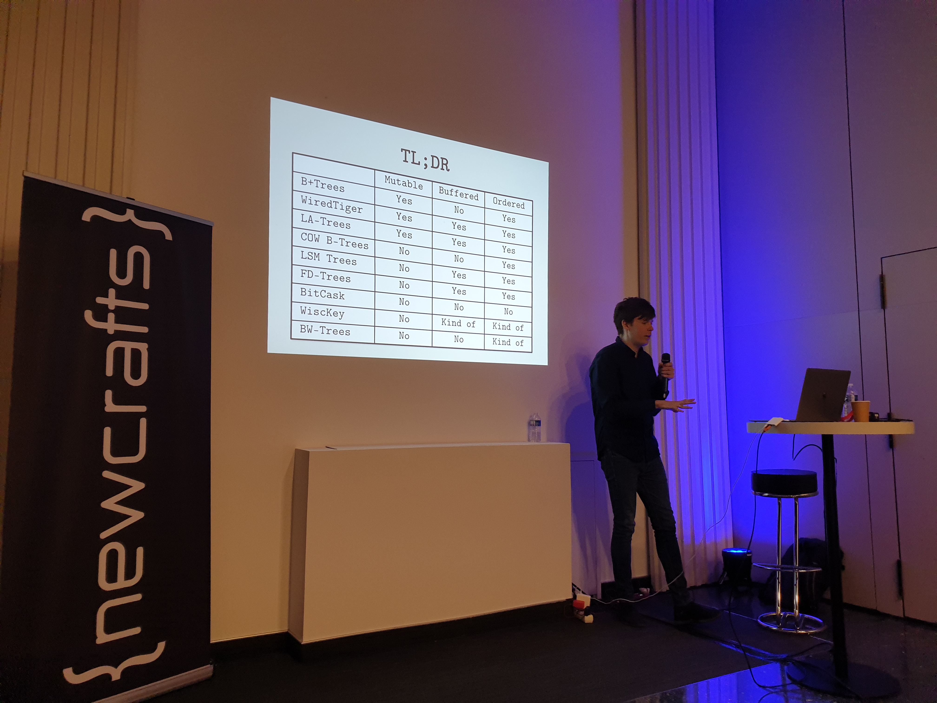
Storage System: The Old, The New, The Overlooked Alex Petrov

Slide 73
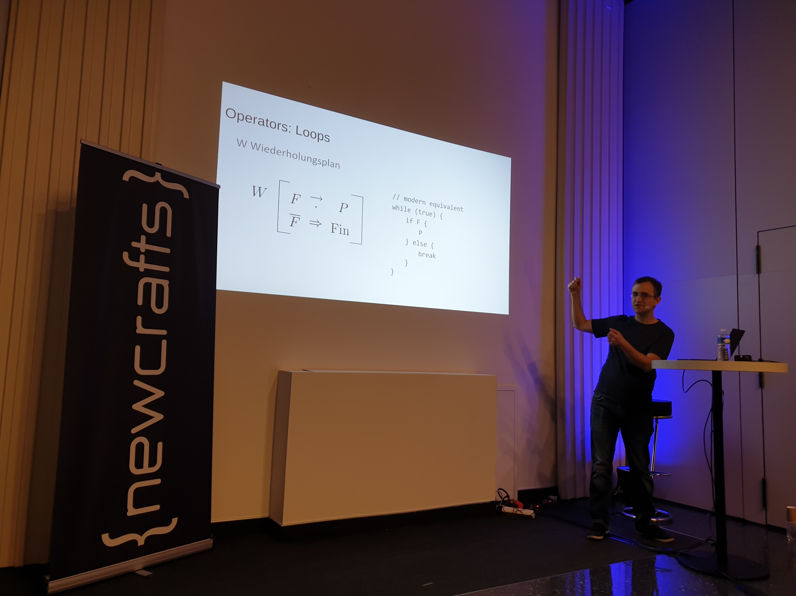
Plankalkül: a high-level language from the 1940s Eric Lefevre-Ardant

Slide 74
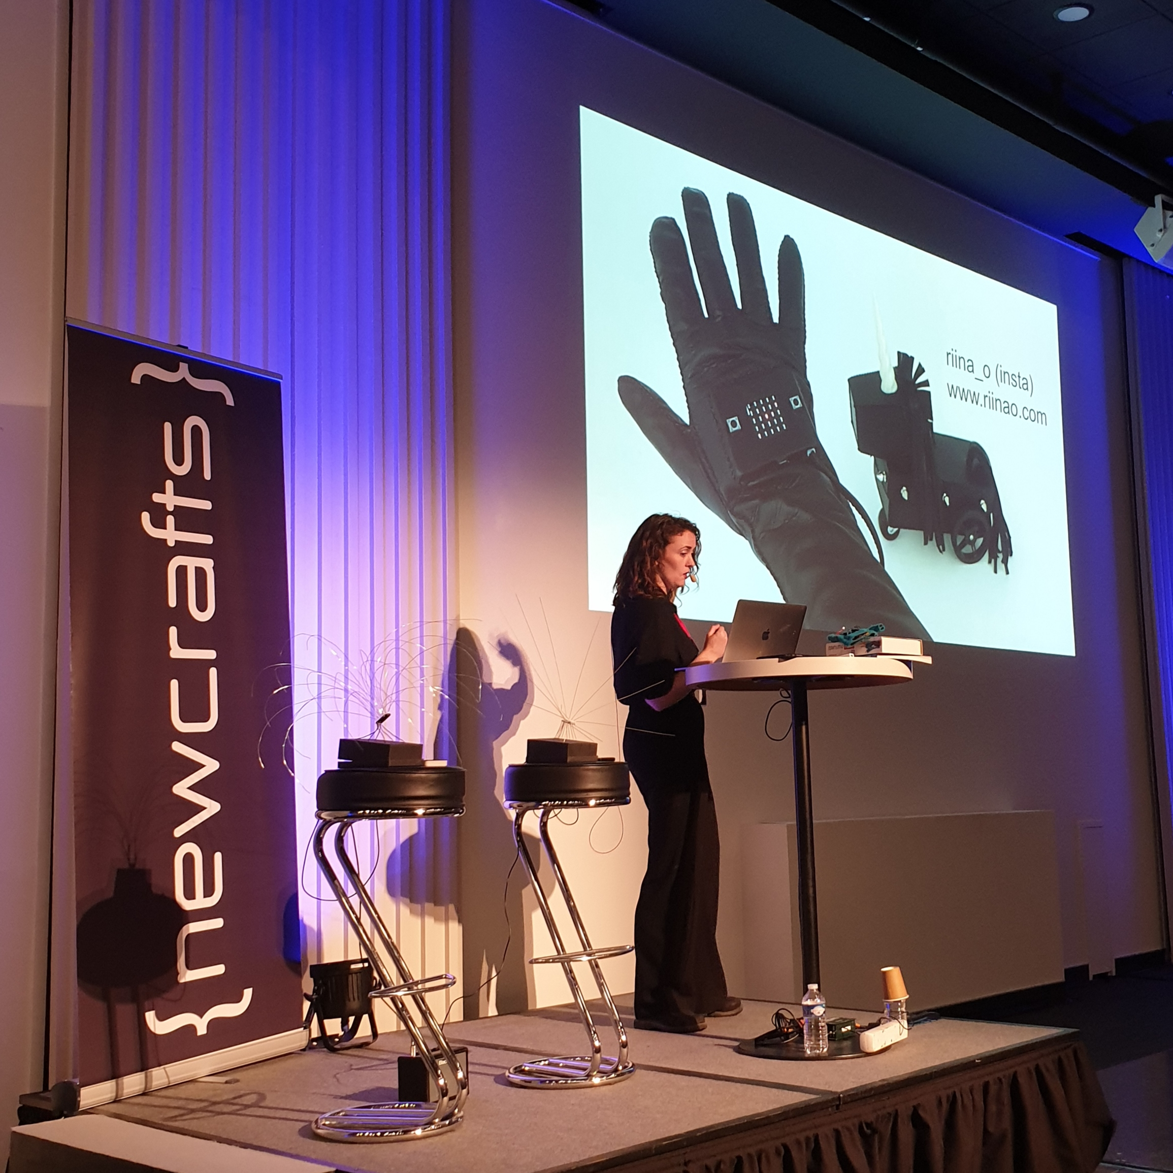
Music tech hacking Helen Leigh

Slide 75
Sjekk også

Slide 76
The Search for Fundamental Software Engineering Principles Tomas Petricek

Slide 77
Learning from How Science and Philosophy Progress Brian Marick

Slide 78
Are Programming Languages Languages? Alvaro Videla

Slide 79
Nihilism and Technology Nolen Gertz

